Slide 1

Daily Review
Reminder
When describing a force, you need to include: What is pushing / pulling what Any changes to the objects’ Speed Direction Shape
Describe the force at work in the picture below.
The ________ is pushing / pulling the ________. This is causing the ________ to change ________.
Vocabulary
force (noun) any push or pull that happens when two objects interact applied force (noun) a simple push or pull
Notes:
45 s → share → popsticks

Slide 2
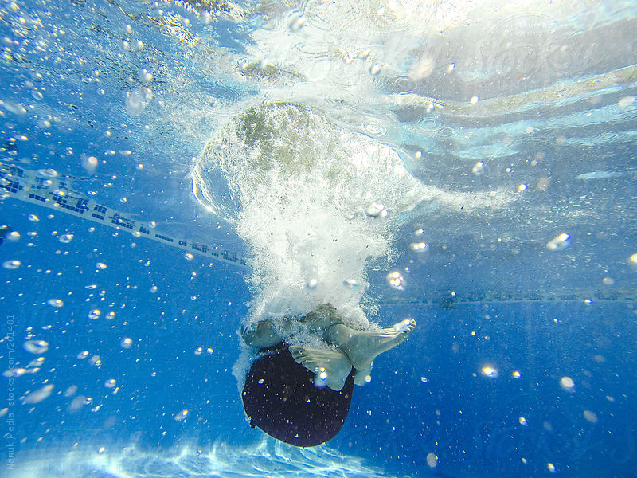
Daily Review
Reminder
When describing a force, you need to include: What is pushing / pulling what Any changes to the objects’ Speed Direction Shape
Describe the forces at work in the picture below.
Vocabulary
force (noun) any push or pull that happens when two objects interact applied force (noun) a simple push or pull
Notes:
45 s → share → popsticks

Slide 3
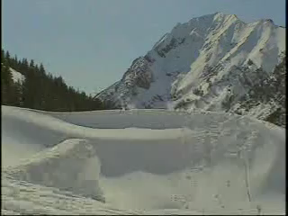
Daily Review
Reminder
When describing a force, you need to include: What is pushing / pulling what Any changes to the objects’ Speed Direction Shape
Describe the forces at work in the video below.
Vocabulary
force (noun) any push or pull that happens when two objects interact applied force (noun) a simple push or pull
Notes:
45 s → share → popsticks

Slide 4
Balanced and Unbalanced Forces Year 7 Science

Slide 5
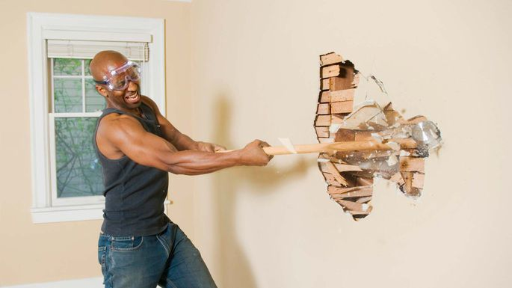
Learning Objectives
CFU 1
What two types of forces are we going to learn about?
Use force diagrams to represent, add and subtract forces
Identify balanced and unbalanced forces
Describe the effects of balanced and unbalanced forces
CFU 2
What do we use to represent forces?
Activate Prior Knowledge
If you were to punch a wall, what would happen to the wall?
What would happen to your fist?
What if you were to use a sledgehammer?

Slide 6

Concept Development
CFU 1
What are forces shown as in force diagrams? Lines Triangles Arrows
Force Diagrams
Force diagrams are simple pictures which show the forces acting on an object.
Forces are shown as arrows. These arrows must:
come out of the object being pushed / pulled
be labelled with the name of the force and/or the amount of force in Newtons (N)
CFU 2
How do you label a force?
CFU 3
Where do force arrows go? Into the object Out of the object Inside the object
F_{push}
200 N

Slide 7
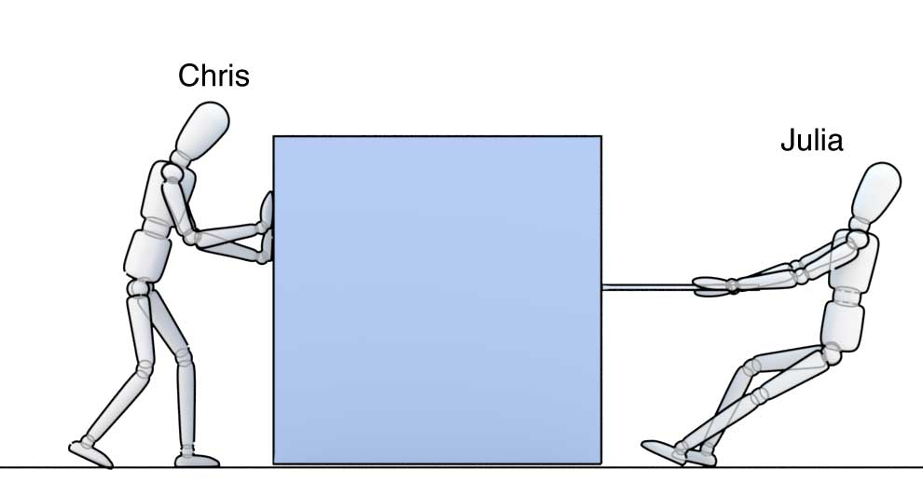
Concept Development
CFU 1
Should these forces be added or subtracted? Why?
Adding and Subtracting Forces
If two forces are going in the same direction, they are added together.
If two forces are going in opposite directions, they are subtracted.
CFU 2
What is the net force on the box?
300 N
500 N
200 N
Vocabulary
Net force The total of all forces acting on an object

Slide 8
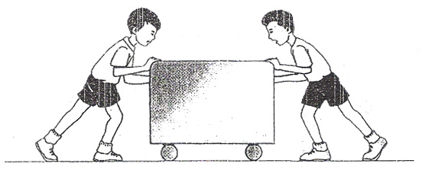
Concept Development
CFU 1
Should these forces be added or subtracted? Why?
Adding and Subtracting Forces
If two forces are going in the same direction, they are added together.
If two forces are going in opposite directions, they are subtracted.
CFU 2
What is the net force on the box?
CFU 3
Which direction is the net force on the box?
85 N
15 N
Vocabulary
Net force The total of all forces acting on an object
100 N

Slide 9
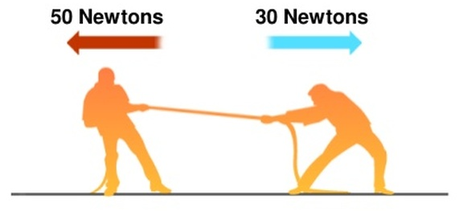
Concept Development
CFU 1
What three things could happen to an object with an unbalanced force acting on it?
Unbalanced and Balanced Forces
If the net force on an object is more than 0 N (zero Newtons), the forces on it are unbalanced. The object will change speed, direction, and / or shape.
If the net force on an object is exactly 0 N, the forces on it are balanced. The object will not change speed, direction, or shape.
CFU 2
What does the net force on an object need to be for the forces on it to be balanced?
CFU 3
Are the forces on the rope balanced or unbalanced? How do you know?
Vocabulary
unbalanced (adjective) forces on an object are not 0 N and will cause a change balanced (adjective) forces on an object are exactly 0 N and will not cause a change

Slide 10
Skill Development / Guided Practice
Vocabulary
unbalanced (adjective) forces on an object are not 0 N and will cause a change balanced (adjective) forces on an object are exactly 0 N and will not cause a change
CFU 1
What does the diagram need to include?
Describing and Drawing Forces
When describing forces, you need to:
Draw a diagram with labelled force arrows.
Do the maths
Add the forces going in the same direction
Subtract the forces going in opposite directions
Describe the net force
Balanced (there is no net force)
Unbalanced (state the net force and its direction)
CFU 2
Which forces get added together?
CFU 3
Which forces get subtracted?
CFU 4
What two things do you need to describe an unbalanced force?

Slide 11
Skill Development / Guided Practice
Describing and Drawing Forces
When describing forces, you need to:
Draw a diagram with labelled force arrows.
Do the maths
Add the forces going in the same direction
Subtract the forces going in opposite directions
Describe the net force
Balanced (there is no net force)
Unbalanced (state the net force and its direction)
Paul and Pamela are pushing a box together. Paul is pushing with 500 N and Pamela is pushing with 450 N.
1.
2.
3.
500 N
500 + 450 = 950
The net force is 950 N to the right.
450 N

Slide 12
Skill Development / Guided Practice
Vocabulary
unbalanced (adjective) forces on an object are not 0 N and will cause a change balanced (adjective) forces on an object are exactly 0 N and will not cause a change
Describing and Drawing Forces
Draw a diagram with labelled force arrows.
Do the maths
Add the forces going in the same direction
Subtract the forces going in opposite directions
Describe the net force
Balanced (there is no net force)
Unbalanced (state the net force and its direction)
Sam and Ash are cracking a Christmas cracker. Sam is pulling with 350 N and Ash is pulling with 475 N.

Slide 13
Skill Development / Guided Practice
Vocabulary
unbalanced (adjective) forces on an object are not 0 N and will cause a change balanced (adjective) forces on an object are exactly 0 N and will not cause a change
Describing and Drawing Forces
Draw a diagram with labelled force arrows.
Do the maths
Add the forces going in the same direction
Subtract the forces going in opposite directions
Describe the net force
Balanced (there is no net force)
Unbalanced (state the net force and its direction)
Bill and Kelly are pushing a car up a hill. Bill is pushing with 550 N and Kelly is pushing with 525 N. The Earth is pulling the car down the hill with 1000 N of force.

Slide 14
Skill Development / Guided Practice
Vocabulary
unbalanced (adjective) forces on an object are not 0 N and will cause a change balanced (adjective) forces on an object are exactly 0 N and will not cause a change
Describing and Drawing Forces
Draw a diagram with labelled force arrows.
Do the maths
Add the forces going in the same direction
Subtract the forces going in opposite directions
Describe the net force
Balanced (there is no net force)
Unbalanced (state the net force and its direction)
Two teams are playing tug-of-war. On one team, Adrian is pulling with 440 N, Britt is pulling with 450 N, and Claire is pulling with 420 N. On the other team, Darren is pulling with 490 N, Edith is pulling with 500 N, and Frank is pulling with 320 N.

Slide 15
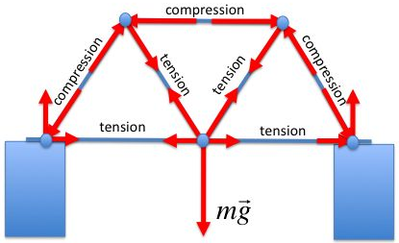
Relevance
Calculating total forces is essential when designing buildings, bridges, furniture, and many other structures.
Drawing diagrams properly makes answering force-related questions much easier.

Slide 16

Skill Closure
Reminder
Draw a diagram with labelled force arrows. Do the maths Add the forces going in the same direction Subtract the forces going in opposite directions Describe the net force Balanced (there is no net force) Unbalanced (state the net force and its direction)
What are changes in speed, direction, and shape caused by?
Balanced forces
Strong forces
Unbalanced forces
Applied forces
For the indoor skydivers to the right:
Draw a force diagram.
Are the people changing speed, direction or shape?
What does your answer tell you about the forces acting on them?

Slide 17
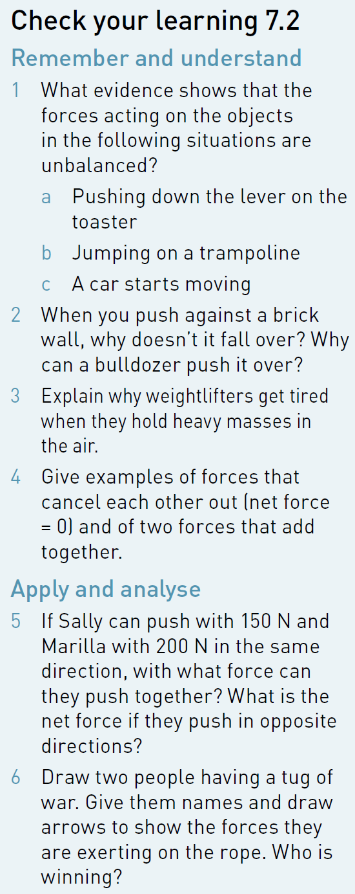
Independent Practice
Complete questions 1-6 on page 123 of your textbook.

